Slide 1

Voice on Two Timescales
Tracking How Authorial Voice Emerges Across a Novel
Honors Thesis Progress Review
Presented by Sid · August 2026

Slide 2

What is Voice?
Voice is the accumulated effect of thousands of micro-decisions an author makes — most of them unconscious. It is not what is said, but how the saying feels.
Readers experience voice as one unified impression.
But that impression is produced locally — word by word, sentence by sentence.
THE CENTRAL PUZZLE
Can local, measurable patterns reconstruct — and help explain — a holistic impression readers form almost instantly?
RESEARCH QUESTION
Do the features that create voice all become recognizable at the same rate — or do some emerge faster than others?
THE TWO-TIMESCALE VOICE HYPOTHESIS
2

Slide 3

From Eight Candidate Features to a Testable Set
Voice can be described at many levels — surface, structural, conceptual, relational. For a computational thesis, only some of that is measurable without building a new AI system. This project uses a division of voice elaborated in “Not All Character N-grams Are Created Equal: A Study in Authorship Attribution”
1
2
3
4
Lexical
Syntactic
Rhythmic
Punctuation
Vocabulary choice, rare vs. common words, type-token ratio
Sentence length, subordination vs. coordination
Sentence rhythm, syllables per word, sentence endings
Comma, dash, semicolon, and exclamation habits
Dataset: 100 English Novels -> https://github.com/computationalstylistics/100_english_novels/tree/master/corpus
Will elaborate on the corpus further in this presentation.
THE RUNNING METHODOLOGICAL PROBLEM
Genre, time period, and translation can all produce the same kind of signal as voice. If Asimov and a contemporary domestic novelist diverge on vocabulary, is that voice — or just science fiction vs. realism? Controlling for this confound became a recurring theme across every following stage.
THE TWO-TIMESCALE VOICE HYPOTHESIS
3

Slide 4

ORIGINAL METHOD
Phase 1 — Chase the Plateau
The starting method: train a classifier to attribute authorship on a growing window of text, and find the point where accuracy stops improving — the presumed moment voice becomes “established.”
1
2
3
Feature vectors
Growing windows
Find the plateau
Character n-grams, grounded in Sapkota et al. (2015): morpho-syntax (prefixes / suffixes), thematic content (whole-word), and style (punctuation) families.
Train an author classifier on text windows from 500 up past 30,000 characters, measuring accuracy at each size.
Locate the window length where accuracy stops climbing — treated as the feature's “emergence point.”
WORKING HYPOTHESIS AT THIS STAGE
Fast-plateauing features are the ones readers unconsciously rely on for their immediate first impression of voice.
THE TWO-TIMESCALE VOICE HYPOTHESIS
4

Slide 5

Phase 1 — Two Dead Ends
1
The Corpus Was Too Thin
2
Accuracy Never Plateaued
The available novel corpus held 33–34 authors, almost all with exactly 3 novels each. Cross-validation folds were capped at 3, and results came back underwhelmingly flat — too thin a sample to trust.
Even out to 30,000 characters, accuracy kept climbing for every feature type. The plateau-detector itself hit a noise floor at this sample size — it couldn't tell a real plateau from random jitter.
What now? To think outside the box
THE TWO-TIMESCALE VOICE HYPOTHESIS
5

Slide 6

The Pivot — Ask Where, Not When
The question changed from “when does accuracy plateau?” to “where in the text is classification accuracy concentrated?”
THE FINDING
Certain character-level features — prefixes, suffixes, mid-word n-grams — show classification accuracy disproportionately concentrated at a novel's opening.
Survived a control for front-matter leakage: the effect shrank by roughly half after removing title/chapter-heading contamination — but did not disappear.
Punctuation categories (e.g. beg-punct) showed almost none of this effect — the pattern is feature-specific, not universal.
Consistent but modest: offset 0 “wins” far above chance (49% vs. a 20% baseline), though the raw accuracy boost itself is small (about 0.01–0.04).
THE TWO-TIMESCALE VOICE HYPOTHESIS
6

Slide 7

Producing a New Hypothesis
Extending the offset sweep out to 100,000 characters — chasing an earlier “double dip” around 8,000–12,000 characters — revealed two distinct shapes, not one:
BURST
ACCUMULATOR
A strong, spiky signal concentrated right at the opening — visible only to small windows.
A weaker, slower, evenly-rising signal that only large windows have the statistical power to detect.
THE TWO-TIMESCALE HYPOTHESIS
“Voice operates on at least two timescales: a strong, concentrated opening burst for certain stylistic markers, layered on top of a separate, slower-accumulating signal that doesn't peak early at all.”
This reconciled two separate feature families, each simply operating on a different timescale
THE TWO-TIMESCALE VOICE HYPOTHESIS
7

Slide 8

A New Test Pipeline for this New Hypothesis
A
B
C
D
COUNT
COMPARE
VERIFY TIMING
CHECK IT'S REAL
Window each novel (local + cumulative); extract a 24-feature battery — sentence length, TTR, hapax rate, punctuation rates, subordination/coordination, syllables/word, function-word rates.
Build a z-scored author-vs-background profile from held-out text; score every window on how far it sits along the author's distinctive axis.
Per feature: a permutation-based burst test and accumulator test, with Benjamini–Hochberg FDR correction across all tests.
Shape descriptors (burst effect, accumulator slope) per feature; cluster to see whether features form real families or a continuum.
NOTE ON RUNTIME
Real novels run 150,000–360,000 words. An incremental O(n) cumulative-feature aggregator replaced an O(n²) version and vectorized numpy permutation tests replaced a looped scipy implementation — both needed before full-length novels were feasible to run.
THE TWO-TIMESCALE VOICE HYPOTHESIS
8

Slide 9

Building a Real Test Corpus
33
100
1839–1930
3 + 1
authors
novels
Victorian & Edwardian
novels/author, plus one Anon
Restricting the corpus to one broad literary period and tradition holds genre and era roughly constant across authors — addressing the confound flagged back in the earliest thesis planning — while still leaving real room for individual stylistic variation.
WHY THIS CORPUS, PRACTICALLY
Earlier corpora (100 mixed English novels, ad hoc Gutenberg pulls) were either too thin per author or too uneven in period to trust. This 100-book, single-tradition set is small enough to run the full pipeline in about a minute but structured enough to support a real 33-author study — with a two-author (Dickens vs. Eliot) pilot run first to validate the method before scaling up.
THE TWO-TIMESCALE VOICE HYPOTHESIS
9

Slide 10

Pilot Study — Dickens vs. Eliot
CLEAN FIT
DIFFERENT PATTERN
George Eliot
Charles Dickens
BURST FEATURES
Also showed a real two-family split in the data — but organized along a rising-vs-falling axis, not the predicted burst-vs-accumulate axis.
fw_of, ttr (q ≈ 0.024)
ACCUMULATOR FEATURES
hapax_rate, semicolon_rate, exclaim_rate (q ≈ 0.004)
Nothing cleared burst significance for Dickens in this run.
A genuine pattern — just not the one the hypothesis predicted. A sign the two-author pilot couldn't settle things on its own.
Matches the two-timescale hypothesis cleanly — a real burst family and a real accumulator family, distinct from each other.
THE TWO-TIMESCALE VOICE HYPOTHESIS
10

Slide 11

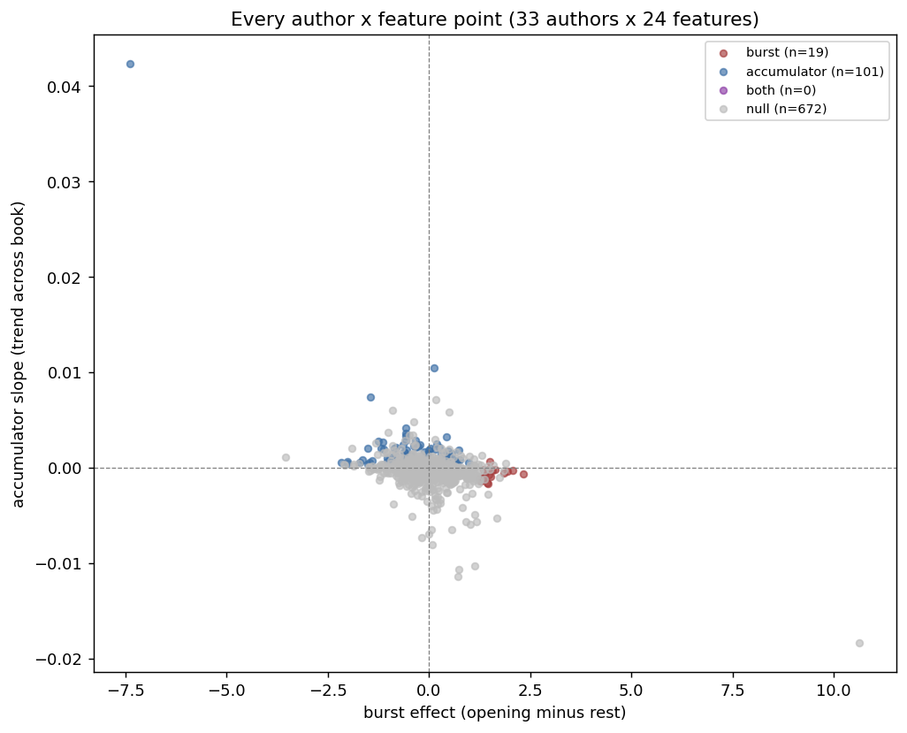
Scaling to All 33 Authors
METHODOLOGY UPGRADE
Each author is compared against a background = the average of every other author's own profile — not pairwise. That makes the run O(n) instead of O(n²) in author count.
One FDR correction is applied once across the entire study, not per-author as in the pilot — appropriately stricter given far more simultaneous tests:
33 authors × 24 features × 2 tests = 1,584 tests
Top features by breadth: TTR, avg. word length, ‘of’-rate, % monosyllabic (~24% of authors each; roughly 3 burst / 5 accumulator split).
THE TWO-TIMESCALE VOICE HYPOTHESIS
11

Slide 12

Conclusions
SUPPORTED BROADLY
The “slow accumulator” half of the hypothesis has broad support across the corpus — accumulation was every feature's dominant pattern, wherever a pattern showed up at all.
REAL, BUT NARROWER THAN EXPECTED
The “opening burst” half is real — but shows up for a small, specific minority of authors and features (19 of 792 pairs), not universally.
The clean two-family split was more visible in the single Eliot comparison than in the full-corpus aggregate, meaning not every author has that “opening burst” of voice distinctiveness
THE TWO-TIMESCALE VOICE HYPOTHESIS
12

Slide 13

Limitations Worth Naming
!
dash_rate outliers
Two extreme effect sizes did not survive FDR correction (q = 0.21, 1.0). Dashes are rare enough that low-usage authors get a near-zero denominator and inflated z-scores. A minimum-count floor would fix this.
!
TTR / hapax_rate sample-size dependence
Both shrink mechanically as window size grows. This affects only the visual cumulative-window plots — the significance tests themselves are local-window based and unaffected.
!
No real POS tagger or CMU dictionary
Neither nltk nor spacy would install in the sandbox. Subordination/coordination rates use a hand-curated word list; syllable counts use a vowel-group heuristic — both noted as limitations in the code and README.
THE TWO-TIMESCALE VOICE HYPOTHESIS
13

Slide 14

Next Steps
1
2
Reframe the Thesis Claim
Analyze Feature-Level Consistencies
Lead with this new, solid finding: accumulation is broad and consistent; the opening burst is too, but narrower
Pivot to the features themselves, and see if certain features have a dominant burst/accumulation pattern
3
Verify with Different Corpuses
Run the pipeline with different databases and see if results are consistent or divergent

